Slide 1

Project – Auto Pilot
Computer Graphics
MIEIC
Circular animation
Teresa Matos
30 April – 1 May 2020

Slide 2
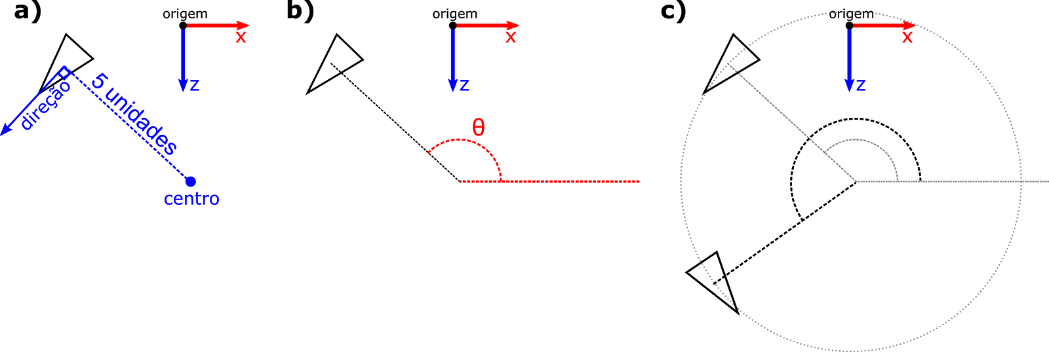
Auto pilot animation
At any frame, the “auto pilot” mode for the vehicle may be activated.
This mode represents a circular animation that:
Starts in the current position and orientation
Has radius of 5 units
Each lap takes 5 seconds

Slide 3
Steps for auto pilot animation
The steps for this animation are similar to the vehicle’s regular animation:
Define initial state
Update current state
Apply state in vehicle’s display

Slide 4
1 Define Initial State - Variables
When the autopilot mode is activated, the initial state is initialized:
Initial state of auto pilot is:
Center of circular animation
Initial angle, relative to X axis
Position
Orientation
The position and orientation are recalculated using the animation’s center and angle
startAutoPilot(...){
… initialize other variables (e.g. radius)
this.center = [Cx,Cy,Cz];
this.pilotAngle = …;
this.position = [Px,Py,Pz];
this.orientation = …;
}

Slide 5
1 Define Initial State - Center
We obtain the center of the animation from the initial position, considering the initial orientation
Calculate perpendicular orientation
Calculate directional vector
Apply directional vector multiplied by radius
Initial position
orientation
directional vector
directional vector * radius
Perpendicular orientation (+ 90 degrees)
Center of animation
Initial orientation

Slide 6
1 Define Initial State – Pilot Animation Angle
The angle around the center is initialized using the vehicle’s orientation
The pilot angle is relative to the positive X axis
this.pilotAngle = this.orientation - 90°
pilotAngle
Current orientation, relative to Z axis
Auto pilot’s initial angle

Slide 7
1 Define Initial State – Position
We now recalculate the position (same value, different methods)
The position is obtained:
1. Starting at the center of the animation…
this.position = center
position
position
orientation
center
center
Unchanged position
Position is moved to center

Slide 8
1 Define Initial State – Position
We now recalculate the position (same value, different methods)
The position is obtained:
2. … translating radius units in animation direction vector’s direction
this.position = center + directionVector * radius
position
position
pilotAngle
pilotAngle
X+ direction
X+ direction
center
radius
center
Calculating the animation direction vector
Multiplying animation direction vector by radius

Slide 9
1 Define Initial State – Orientation
We now recalculate orientation (same values, different method)
The vehicle’s orientation is perpendicular to pilotAngle
this.orientation = pilotAngle + 90°
position
pilotAngle
position
orientation
X+ direction
center
Recalculated position
Recalculated orientation

Slide 10
2 Update Current State – Speed
The position and orientation are calculated at every call for update()
We need to calculate the angular speed, considering the animation’s time
Considering that we want to perform a complete rotation in 5 seconds:
angularSpeed = 360° / animationTime (5 seconds)

Slide 11
2 Update Current State – Elapsed Time
To ensure that the animation occurs in 5 seconds, we need to update our state according to the elapsed time between frames
deltaTime = (currentTime – previousTime) / 1000;
The update(t) function from MyScene receives the current time (ms)
Time t is passed to the vehicle’s update(t) function
To obtain deltaTime in seconds

Slide 12
2 Update Current State – Incremental Angle
Using the elapsed time, we calculate the angle to rotate between previous and current frame - delta angle (applying rule of 3 with angular speed)
deltaAngle = deltaTime * angularSpeed;
The deltaAngle is added to pilotAngle, which is used to recalculate the position and orientation (as done in the previous step).

Slide 13
3 Apply state in display
The display() function is not changed when applying the auto pilot mode
display(){
translate(this.position);
rotate(this.orientation);
…
objects.display();
}

